Slide 1
Protein Pow(d)er
Programmeertheorie, Week 1, Presenteersessie 2
Team: Shire Peasants 3
Authors: Mark Dzoljic, Loek van Steijn, Sebastiaan Kruize

Slide 2
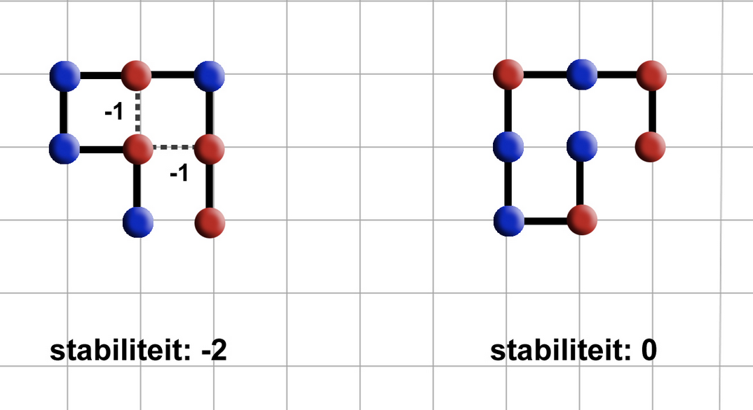
Introduction: Stability of proteins
As more hydrophobic amino-acids (red) are next to each other, the more stable it is
Stability of 0 means unstable
Stability of -2 means more stable.
Goal is to find protein structures that are as stable as possible.

Slide 3
Datastructures
Dictionaries
Use dictionaries to store elements with coordinates. Bind them with a direction variable
Matrixes
Use of a matrix object to store elements.

Slide 4
Heuristics
Constrained Optimization Problem
Constraints
Amino-acid string is given
All amino-acids must be used
Amino-acids cannot overlap
Optimization
Legitimate solution with the highest

Slide 5
State Space en upper/lower bounds
Statespace
→ 4^{n}
Amino acids cannot overlap
→ 4*3^{n}
→ 3^{n-2}
Upperbound: 3x
Met x is aantal H-elements
Lowerbound: > 0

Slide 6
Method: Possible algorithms
Name | Result | Method | Ω (Best Case) | O (Worst Case | Average with 100 attempts
Random | Sub-optimal | Constructive | n | n | -
Greedy | Sub-optimal+ | Constructive | n | n | -
Lineair | Optimal | Constructive | n | n | -
Future | - | - | - | - | -

Slide 7
Questions and comments?
Our questions:
Best method for storing our data structures
How to prevent a protein ‘folding onto itself’
Thank you for your attention

